Slide 1
Functions with Parameters

Slide 2
What are Parameters?
Parameters allow a programmer to customize the functionality of a function based on the information the user provides to it.

Slide 3
An Example
Imagine a function that you make that can add two numbers. It might look as follows:
void sum(){
int n1=Convert.toInt16(txtNum1.text);
int n2=Convert.toInt16(txtNum2.text);
int answer=n1+n2;
lblAnswer.text=Convert.toString(answer);
}

Slide 4
How Can I Use This Function?
Because it’s a function I can use it anywhere in the class that it was made! However I must always get the two numbers from the same 2 textboxes and place the answer in the same label.
This is not very efficient or practical. If I wanted to get the numbers from somewhere else then I would need to create a whole new function.

Slide 5
Solution?
Create a function with parameters that allows the function to get its values from anywhere!
Here’s how it’s done:
int sum(int n1,int n2){
int answer=n1+n2;
return answer;
}

Slide 6
Break It Down
return type-the type of value the function generates/returns
The parameters-the variables that will be used to store the values passed to the function
int sum(int n1,int n2){
int answer=n1+n2;
return answer;
}
The value to return

Slide 7
How is the function used?
When you use a function, although not necessary, it is always good programming practice to assign the value returned/generated by a function to a variable first before using it:
int x=sum(8,9);
int y=sum(Convert.toInt16(txtNum1.text),Convert.toInt16(txtNum2.text));
Int z= sum(x,y);

Slide 8
More info
You have as many parameters and types of parameters as required
You can only return 1 value
The return type on the function must always match the value returned
The parameters can be of any type

Slide 9
Example of Mixed Data Types
Boolean validInt(String value, int range){
int number=Convert.toInt16(value);
if(number>=0 && number<=range)
return true;
else
return false;
}
Can you explain how this function works and what it does?

Slide 10
Exercises
Create a program that allows a user to enter the number of quarters, dimes, nickels and pennies they have and in return get its total value (see following slide for the GUI). Name the function totalValue. It should have 4 parameters representing the quantity of each coin. The following is an example of the code that might be used in the button’s click event:
int q=Convert.toInt16(txtQ.text);
int d=Convert.toInt16(txtQ.text);
int n=Convert.toInt16(txtQ.text);
int p=Convert.toInt16(txtQ.text);
double amount=totalValue(q,d,n,p);
lblTotal.text =”Total $” + amount;

Slide 11
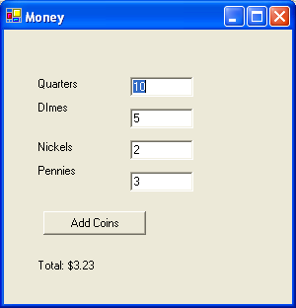

Slide 12
Create a program that allows a user to determine the metric equivalence of an imperial value. For example 2 inches is equal to 5.08 centimetres. Your code should include functions that perform the necessary conversions:
For example, there should be a inchesToCm(double inches) function that takes the number of inches and returns the equivalent number of centimeters.
Sample code for the Miles to Kilometres click event should look as follows:
double m=Convert.toInt16(txtMiles.Text);
double km=milesToKm(m);
lblConversion.text= km+””;

Slide 13
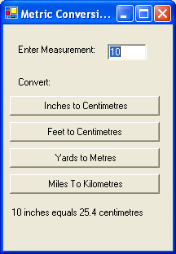

Slide 14
You Design the Form Exercises
The following describes the function you need to make. You will need to design the form to test it.
Create a function called validInt() that has lowNum, highNum and number parameters. The function checks to see that the number is between lowNum and hghNum and return true if this is the case, otherwise it returns false.

Slide 15
Create a function that takes the three dimensions of a 3D rectangle. The function should returns its volume.
Create a function that has two parameters: one parameter takes the number a person thinks a pair of dice will roll to and the second takes their bet. The function returns the amount of money they get based on their bet. The function will generate a random roll of dice, sum it and compare this value with that passed as an argument. If the values match then double the bet and return this value otherwise return 0.

